Slide 1
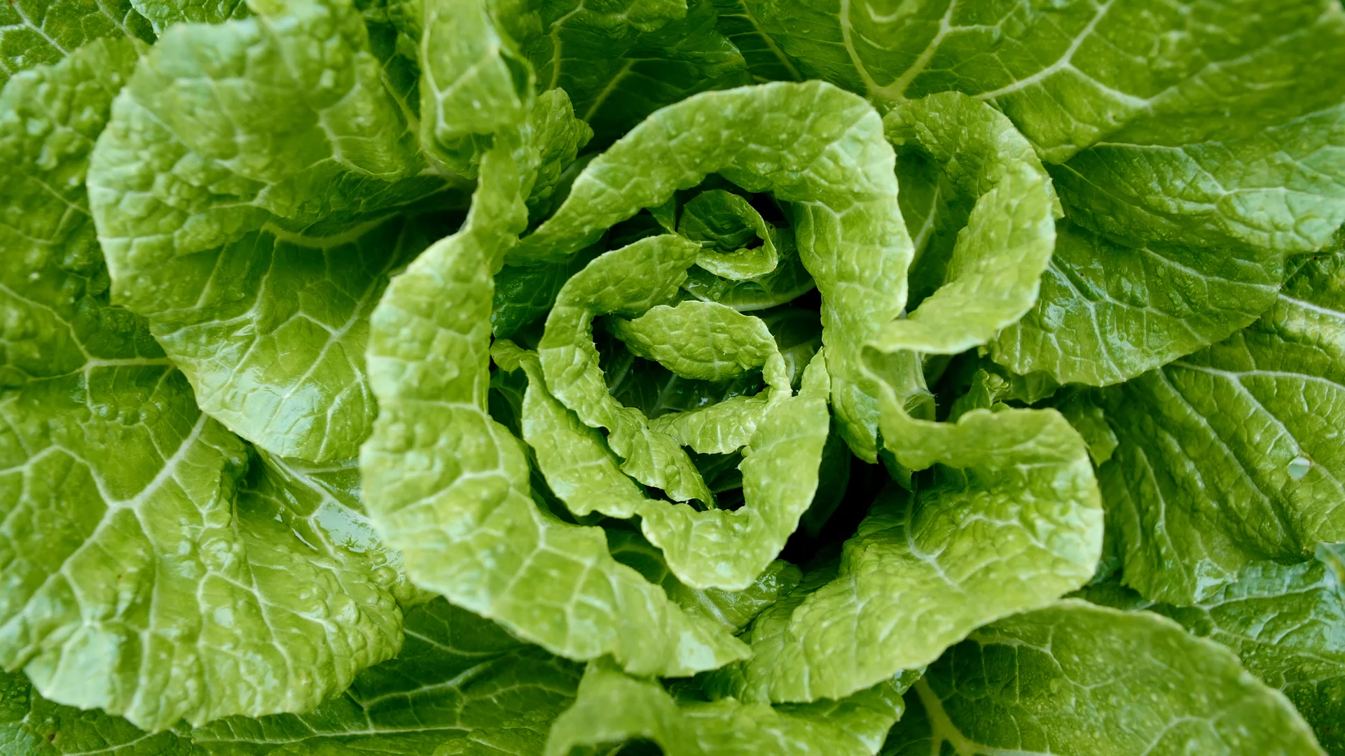
Classifying apple leaf disease with CNN and transfer learning.
by Brian Ingram

Slide 2

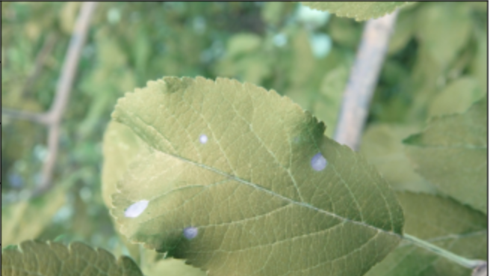
Why is this important?
Apples are one of the most important temperate fruit crops.
Diseased plants can have a strong impact on harvest yield and quality.
Apple leaf disease is found by hand which is time consuming and costly.
Plants are people too! Plants are living things and improving plant life is important.

Slide 3
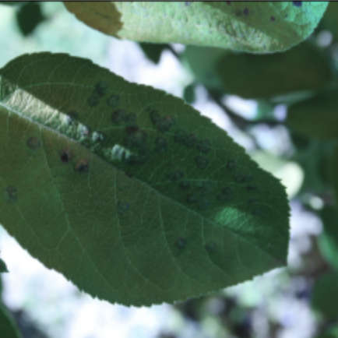
The data
This data set is from the Plant Pathology 2021 – FGVC8 code competition.
The training set contains about 18,600 RGB Fine Grained Visual Cat images of apple leaves.
There is also a corresponding csv file that contains the image ID and labels which are target disease classes.
Memory limitations will not allow 18,000 images to be used. A smaller training set of 10,240 images will be trained and processed.
A test set will be made from the remaining training set (2559 images)
Notes:
https://www.kaggle.com/c/plant-pathology-2021-fgvc8/overview

Slide 4
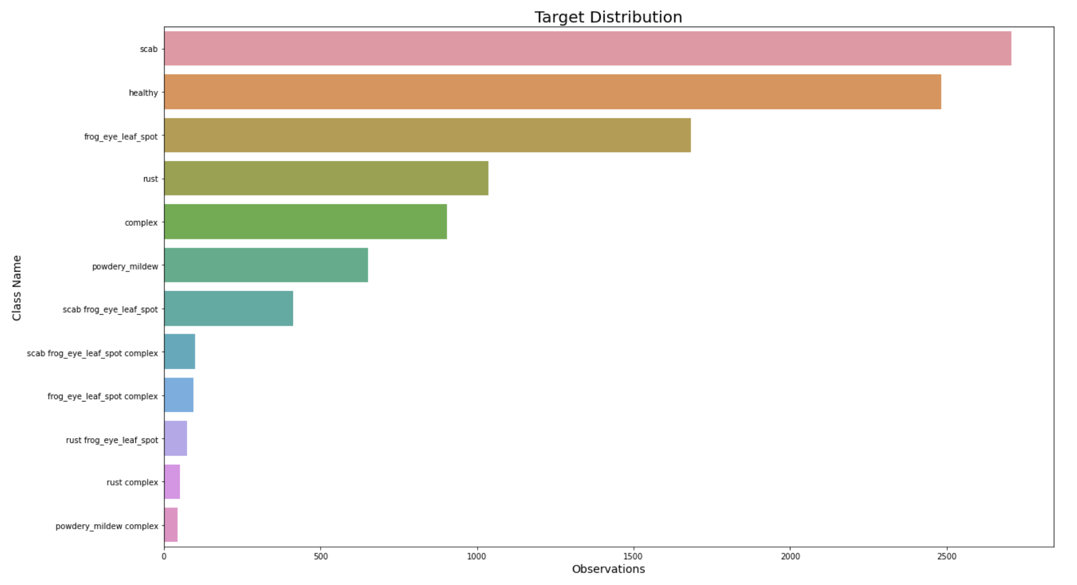
This plot shows the frequency of disease classes. 12 total disease classes exist but some are combinations of classes, and some contain spaces which a convolutional neural network (CNN) will have trouble with. The labels will be one-hot encoded where the presence of a class will be denoted by a 1 and the absence will be a zero. We will use only the six unique and most prominent classes for classification.

Slide 5
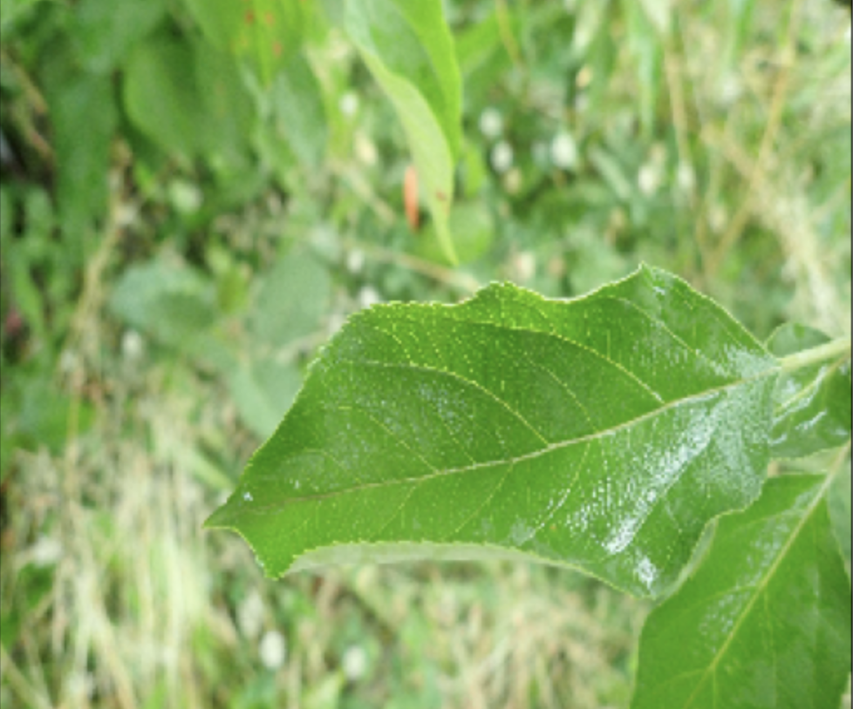
Disease classes - Healthy
These leaves should exhibit no evidence of disease exclusive of the other classes and serve as a baseline.

Slide 6
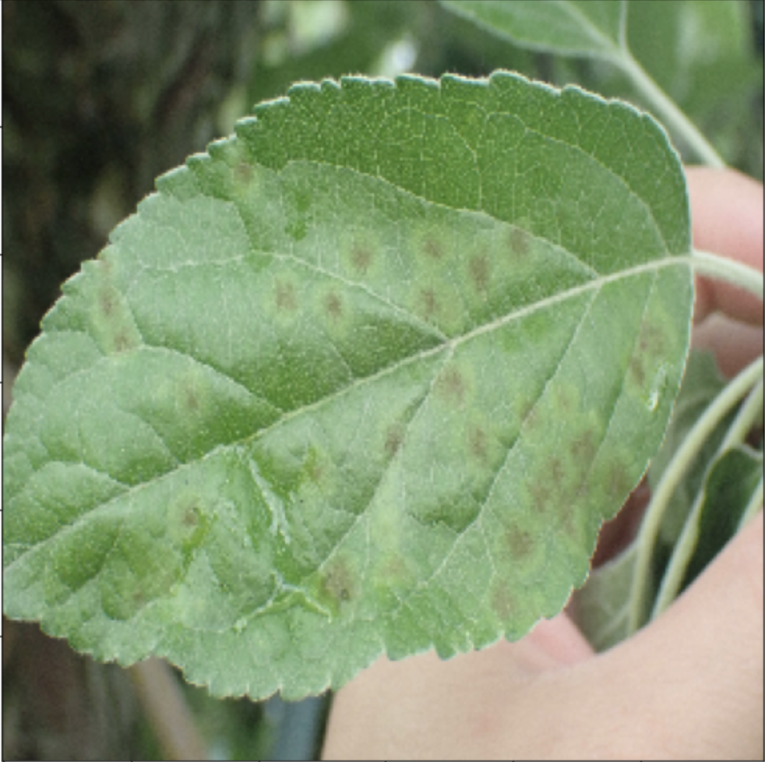
Disease classes - Scab
Scabs are a fungal disease that forms pale yellow or olive-green spots on the upper surface of leaves. Dark, velvety spots may appear on the lower surface. Severely infected leaves become twisted and puckered and may drop early in the summer.
Notes:
https://www.planetnatural.com/pest-problem-solver/plant-disease/apple-scab.

Slide 7
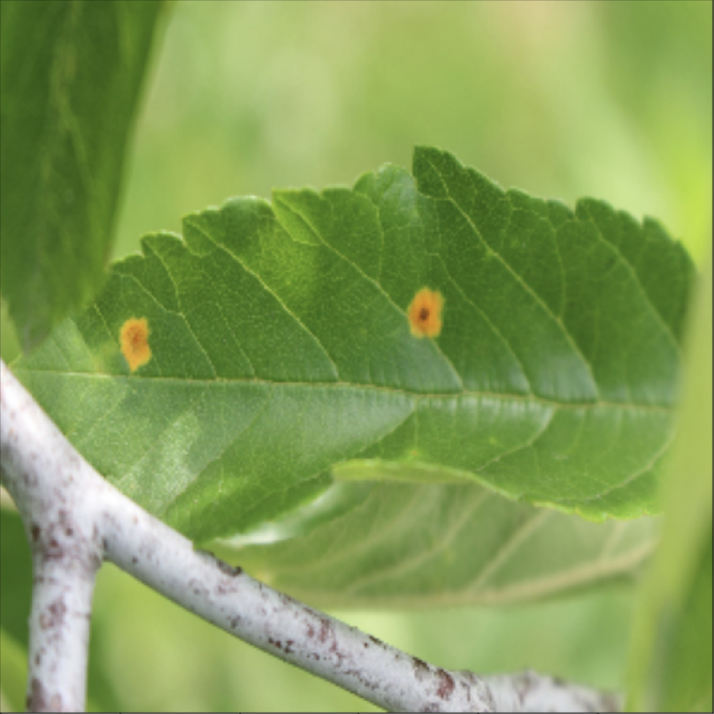
Disease classes - Rust
Circular, yellow spots (lesions) appear on the upper surfaces of the leaves shortly after bloom. In late summer, brownish clusters of threads appear beneath the yellow leaf spots or on fruits and twigs. The spores associated with the threads the leaves during wet, warm weather.
Notes:
http://shadetreesnursery.com/common-garden-plants-diseases

Slide 8
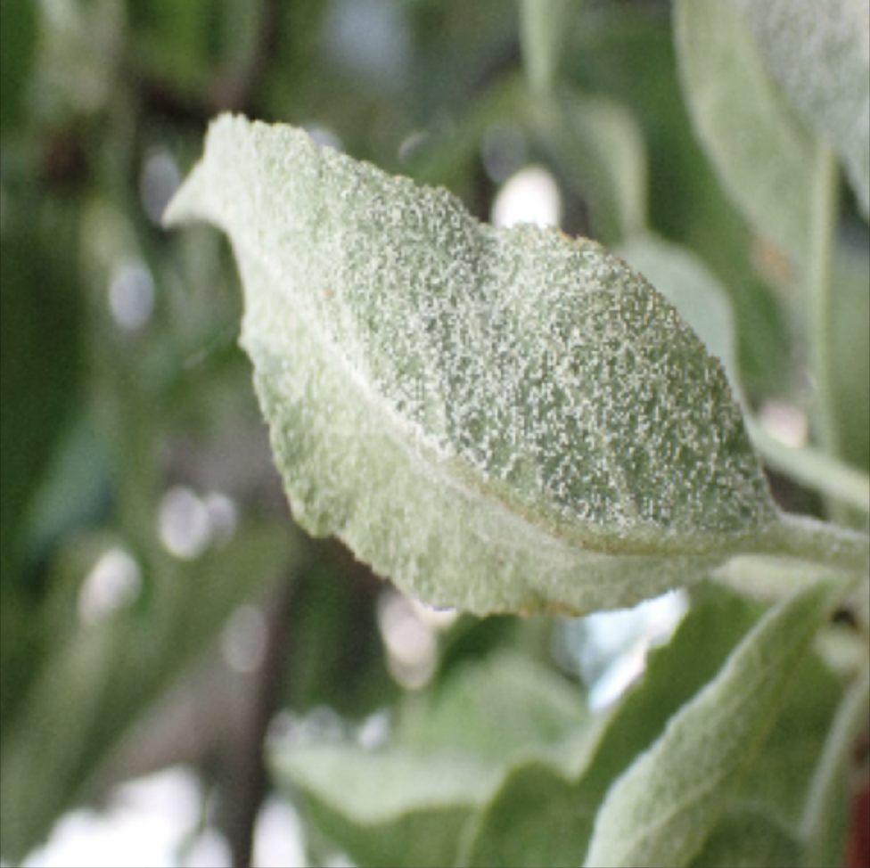
Disease classes – Powdery Mildew
Powdery mildew is a fungal disease that affects a wide range of plants and is one of the easier plant diseases to identify. Infected plants display white powdery spots on the leaves and stems. As the disease progresses, the spots get larger and denser, and the mildew may spread up and down the length of the plant.
Notes:
https://en.wikipedia.org/wiki/Powdery_mildew

Slide 9
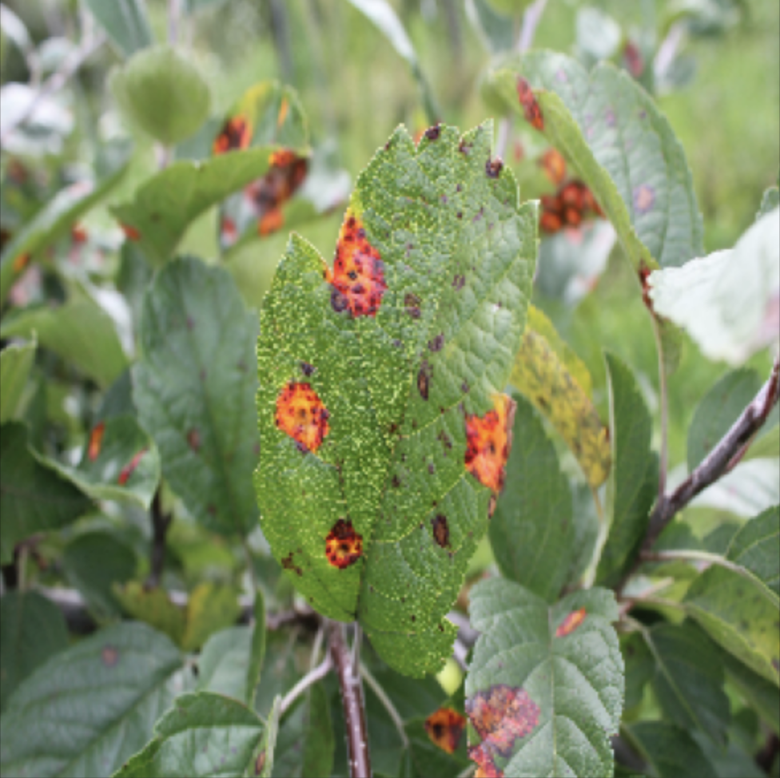
Disease classes – Frog eye leaf spot
First, small purple spots form on the leaves. These spots gradually enlarge and eventually develop into lesions with a light tan interior, surrounded by a dark purple perimeter. Heavy infections of frog-eye leaf spot can cause leaves to turn yellow and drop.
Notes:
http://www.omafra.gov.on.ca/english/crops/pub360/notes/appleblrot.

Slide 10
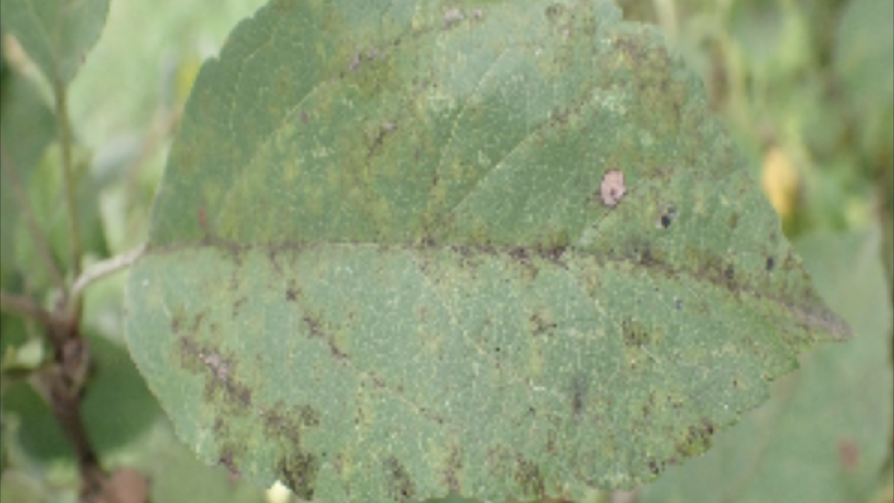
Disease classes - Complex
Unhealthy leaves with too many diseases to classify visually will have the complex class and may also have a subset of the diseases identified.
Notes:
https://www.kaggle.com/c/plant-pathology-2021-fgvc8/data

Slide 11
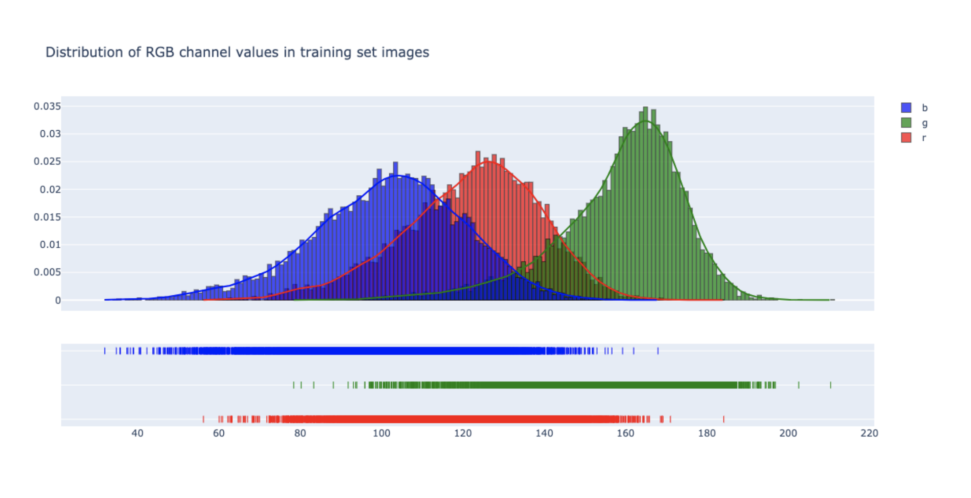

Slide 12
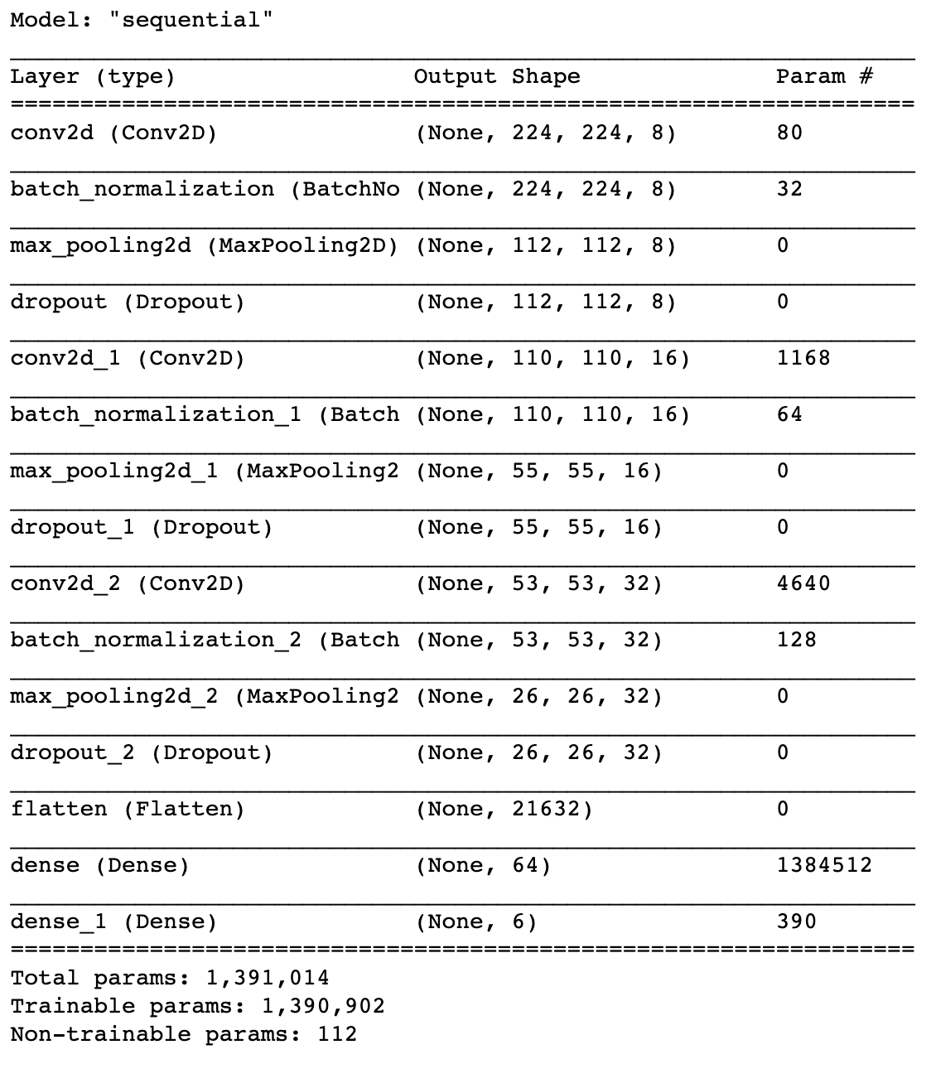
My CNN
Even with 1,391,014 parameters, this neural network does not have enough parameters to classify over 10,000 images of apple leaves. On to transfer learning.

Slide 13
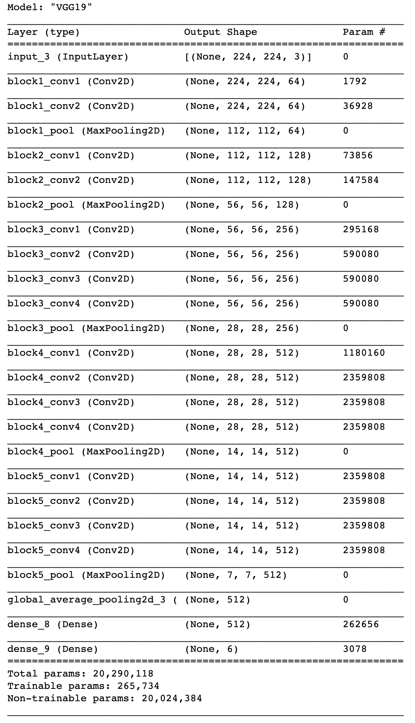
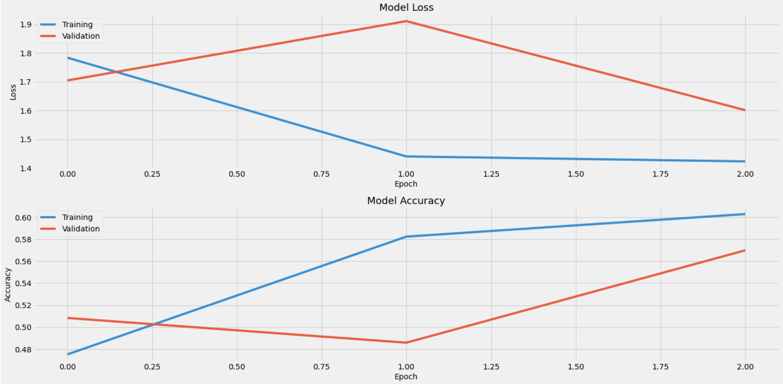
VGG19
Only 3×3 convolutional layers stacked on top of each other in increasing depth. Reducing volume size is handled by max pooling. Long time to train and large network architecture weights. May need more than 3 epochs.

Slide 14
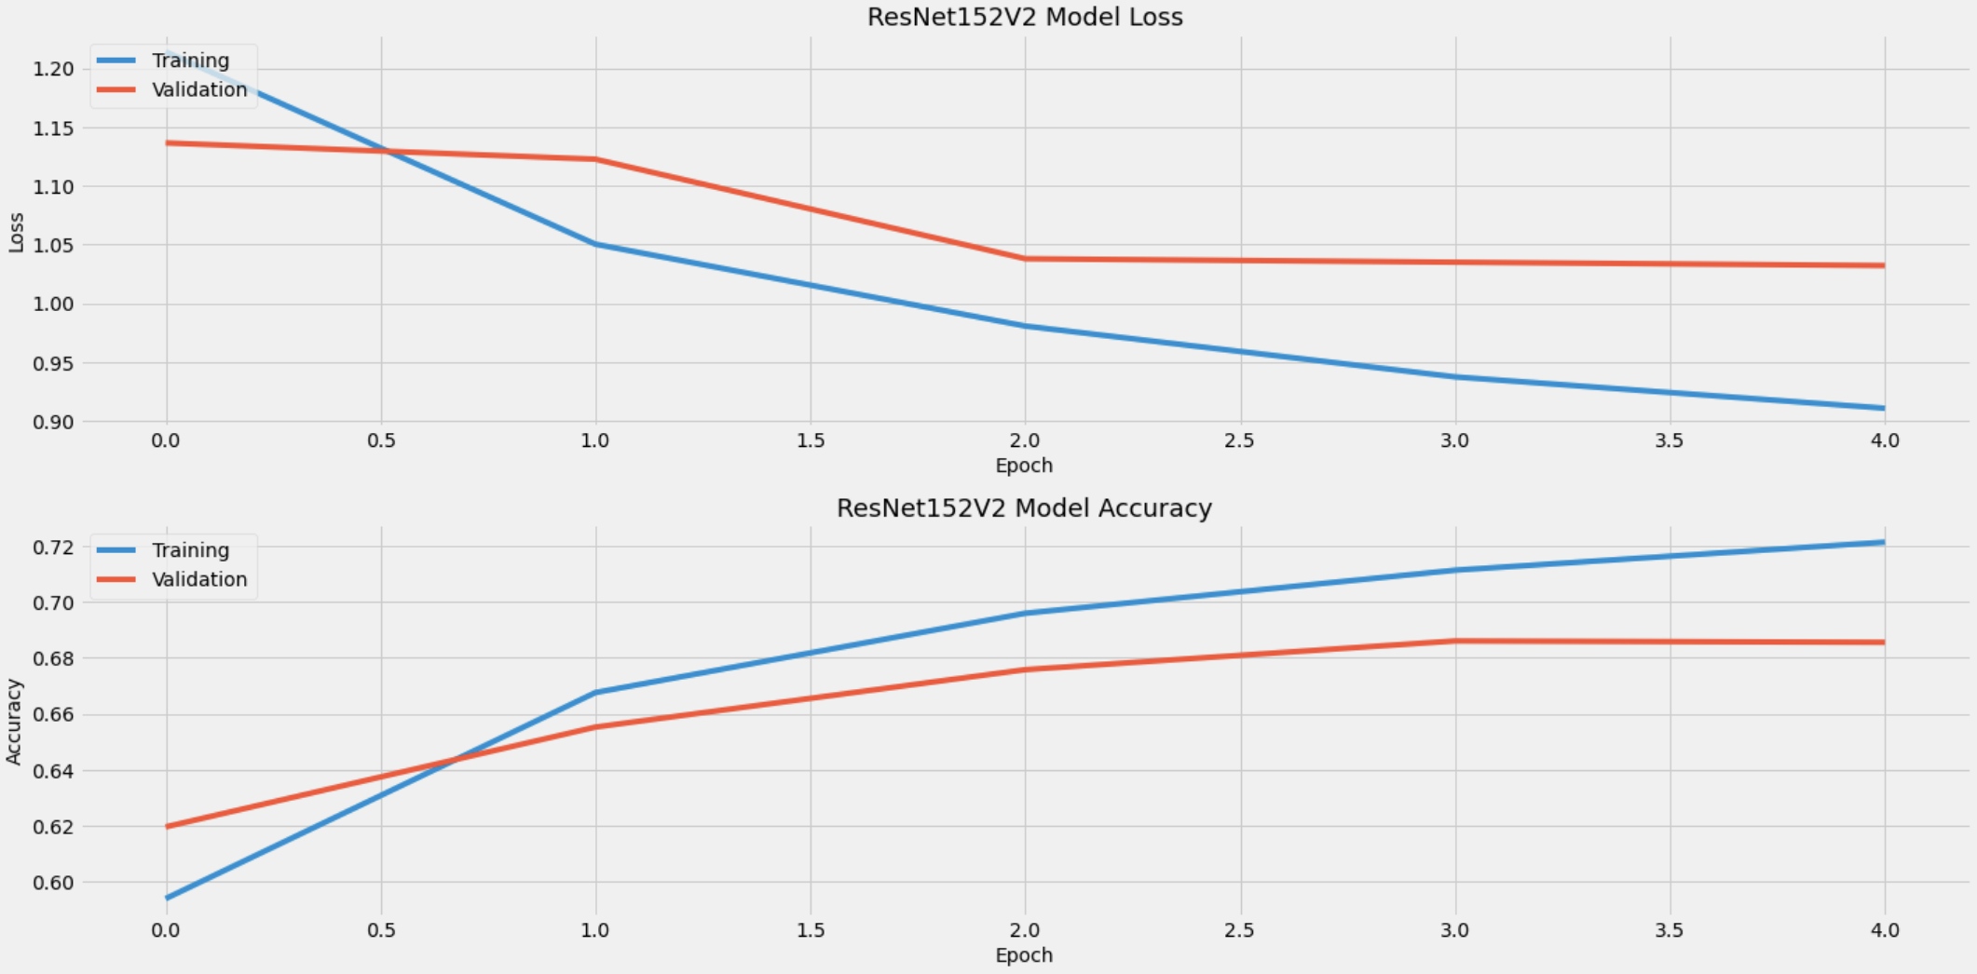
ResNet152V2
ResNet relies on micro-architecture modules called network-in-network architectures that are much deeper than VGG19 and the model size is smaller. ResNet stands for the use of residual modules that can train extremely deep networks with stochastic gradient descent.

Slide 15
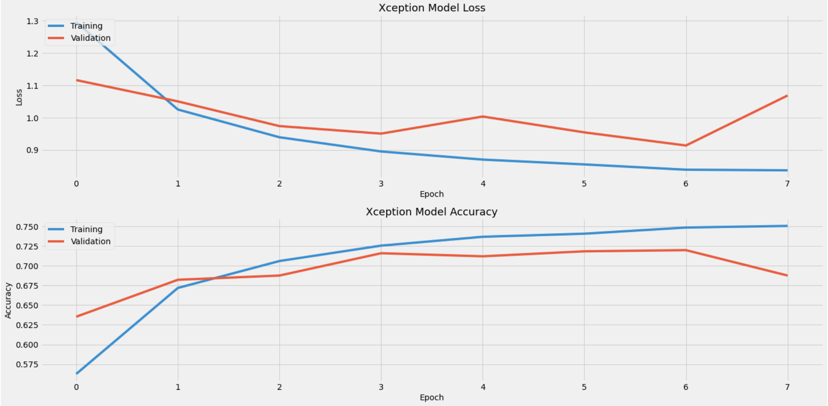
Xception
Xception, which was developed by the creator of Keras, François Chollet, is an extension of the Inception architecture which replaces the standard Inception modules with depth-wise separable convolutions.

Slide 16
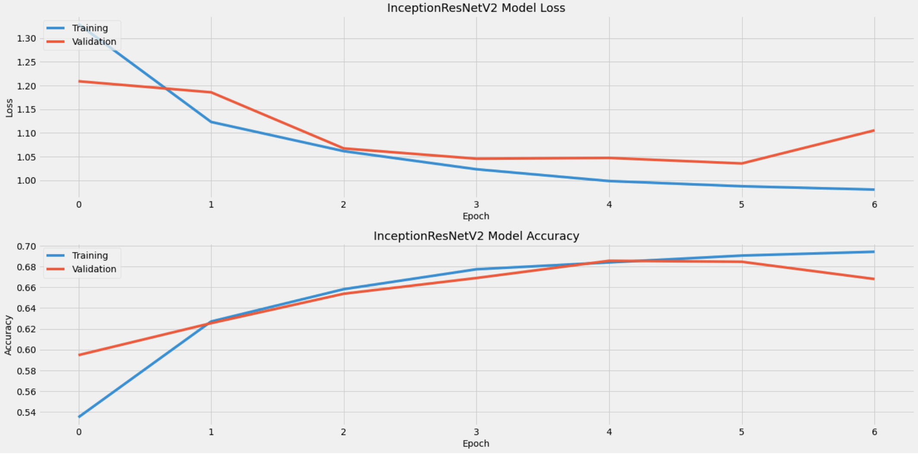
InceptionResNetV2
InceptionResNetV2 is a convolutional neural architecture that builds on the Inception family of architectures but incorporates residual connections replacing the filter concatenation stage of the Inception architecture.

Slide 17
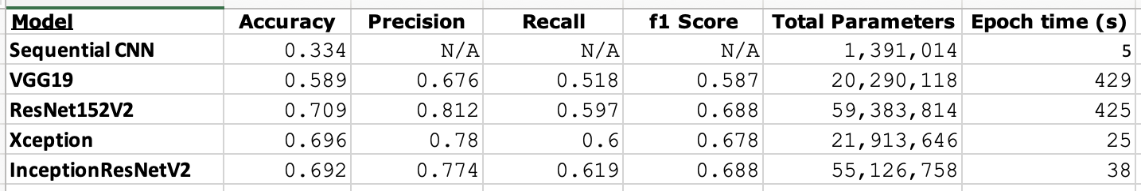
Transfer learning metrics summary
The figure above depicts accuracy, precision and recall for the CNN models on the test set of images after training on the training set. The ResNet152V2, Xception and InceptionResNetV2 perform very similarly on the test data. The VGG19 model did not perform as well. Xception and InceptionResNetV2 fit very quickly where ResNet152V2 and VGG19 were sluggish. All models were run on a TPU with high-RAM on Google Colab.

Slide 18
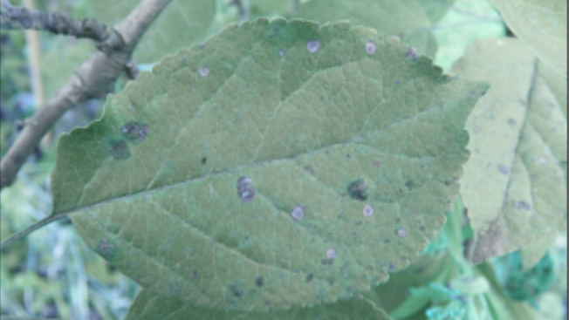
What could be improved?
There was not enough RAM available to read all the images provided in the initial Kaggle training set into Google Colab. A larger data set could provide more accuracy and precision during training.
Leaf color and leaf morphology, non-uniform image background, and different light illumination during imaging may require more image pre-processing before modeling.
PyTorch is more advanced with some of the object-oriented programming functions that can be utilized which could improve training efficiency and modeling accuracy.

Slide 19
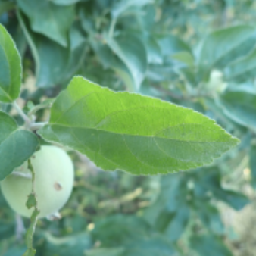
Uses for these models
The ResNet152V2, Xception or InceptionResNetV2 models can be used to identify the 5 most popular classes of apple leaf disease with respect to healthy leaves with close to 70% accuracy.
These models can reduce labor costs and increase profits due to increased efficiency during harvest and cultivation.
These models can also be used on other cases of plant pathology improving the health of various types of plants.
These models can be used as a basis for development of models that can predict plant disease before it begins.

